Slide 1
Correlation
RX 319
Introduction to Healthcare Analytics

Slide 2
Learning Objectives
Contrast correlation and regression.
Use cor() and cor.test() to correlate two numeric variables.
Interpret the results of a correlation test.
2

Slide 3
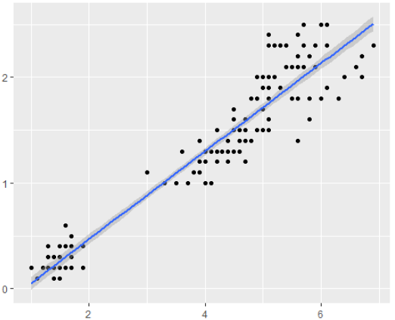
Correlation & Regression
Correlation
Regression
How strongly are they related?
Predict one variable from the other
cor = 0.96
y = -0.36 + 0.42x
3

Slide 4
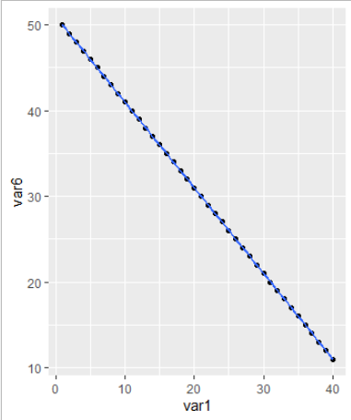
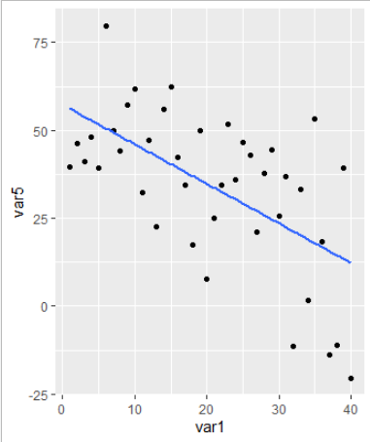
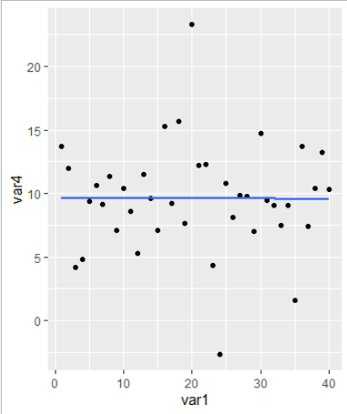
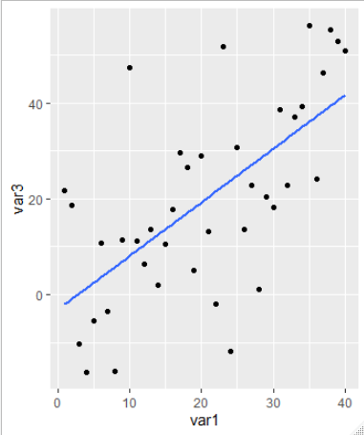
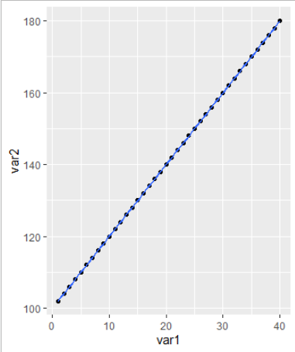
Correlation
cor = -1
cor = -0.5
cor = 0
cor = 0.5
cor = 1
Strong negative correlation
No correlation
Strong positive correlation
Correlation says how well the dots fit on the trendline – “If I know one number, can I guess the other?”
It does not say anything about the slope (except if it goes up or down).
Another way: Spearman’s method (Optional)
4

Slide 5
A correlation test in R
cor() just gives you the correlation coefficient.
> cor(vector1, vector2)
0.3167609
cor.test() conducts a statistical test for the correlation.
> cor.test(vector1, vector2)
data: vector1 and vector2
t = 1.9208, df = 48, p-value = 0.0407
alternative hypothesis: true correlation is not equal to 0
95 percent confidence interval:
0.0462619 0.6659353
sample estimates:
cor
0.3167609
5

Slide 6
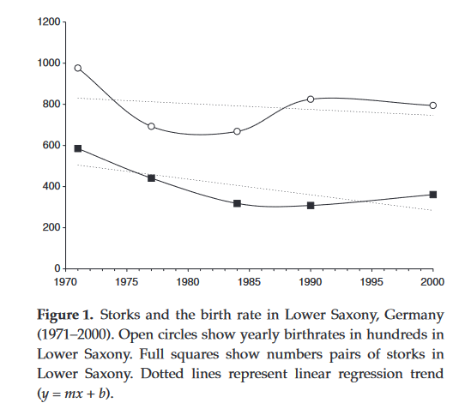
Correlation Doesn’t Imply Causation
The two variables are related, but what does that mean?
It might mean that one causes the other one
Or maybe another variable causes both of them!
Example
In Germany, birth rates were found to be higher in years when more storks were counted.
More storks cause higher birthrates
Storks deliver babies!
“New Evidence for the Theory of the Stork.”
https://web.stanford.edu/class/hrp259/2007/regression/storke.pdf
6

